Slide 1
Pulse Stretching and VQE Optimization (2)
Meeting with Professor Schnetzer and Rikab
August 24, 2020

Slide 2
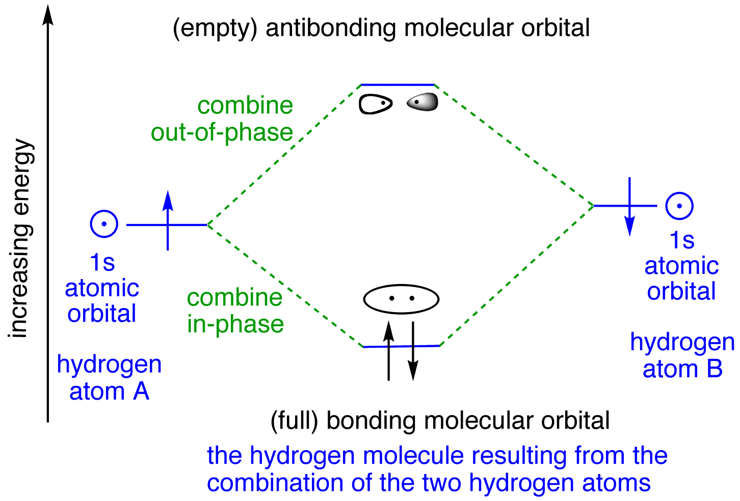
Hydrogen Molecule Parameters

Slide 3
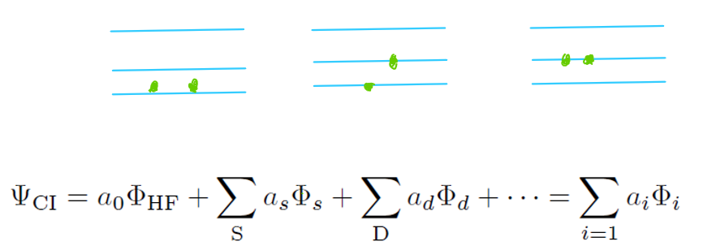


What are Chemists doing? Configuration Interaction
Recognizes contribution of excited states to correlation energy
If given a complete basis set, provides exact solution

Slide 4
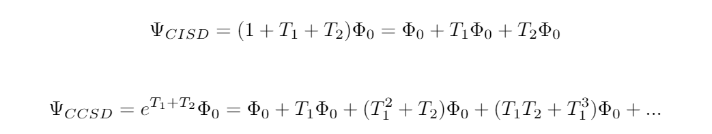
What are Chemists Doing? Truncated CI and CC
Configuration Interaction Singles and Doubles
Coupled Cluster Singles and Doubles
Single Excitations
Double Excitations
Triple Excitations

